Slide 1

Final Demo Omer Pahima Amit Cohen Dean Biton Shirley Fichman

Slide 2
Project Background
As students, some of us have already encountered the struggle of finding a job. We thought it would be a great idea to create a platform in which job seeking will be easier and smoother
A platform that both job seekers and employers can use, so the goal of finding the right employer/employee will be made in the most efficient way

Slide 3
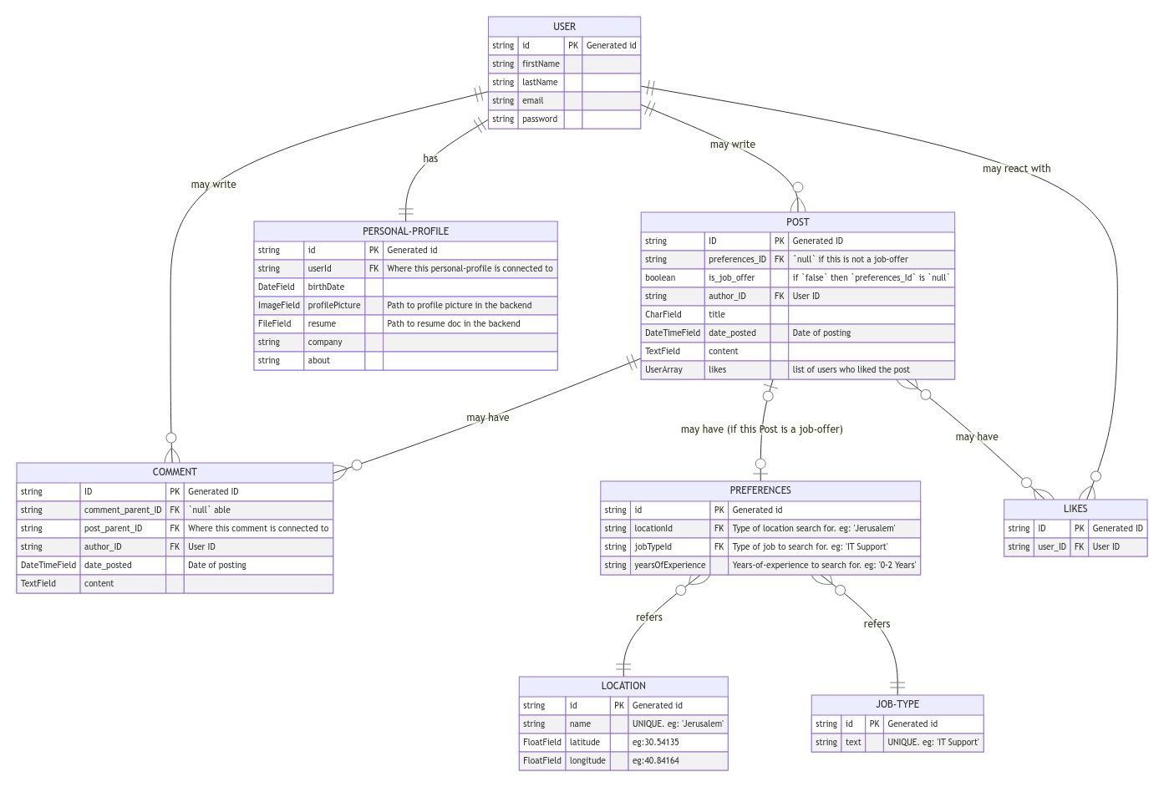
Architecture - ERD

Slide 4
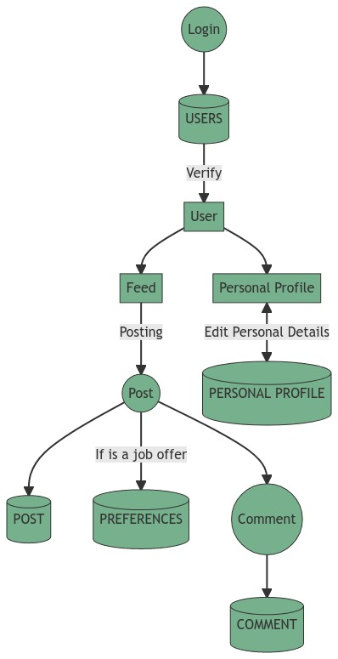
Architecture - DFD

Slide 5







Architecture
Frontend
Backend
Database

Slide 6
Development process
Brainstorming different project ideas
Requirement specification
Setup the development environment
Design and build the ORM
Creating the apps: Feed, Personal Profile and Job Board
Upgrading UI
Filling DB

Slide 7
Development challenges and what we learned
We had a leave of one of our team members
Asynchronous work with PRs
Working as a team
Working with git and github

Slide 8
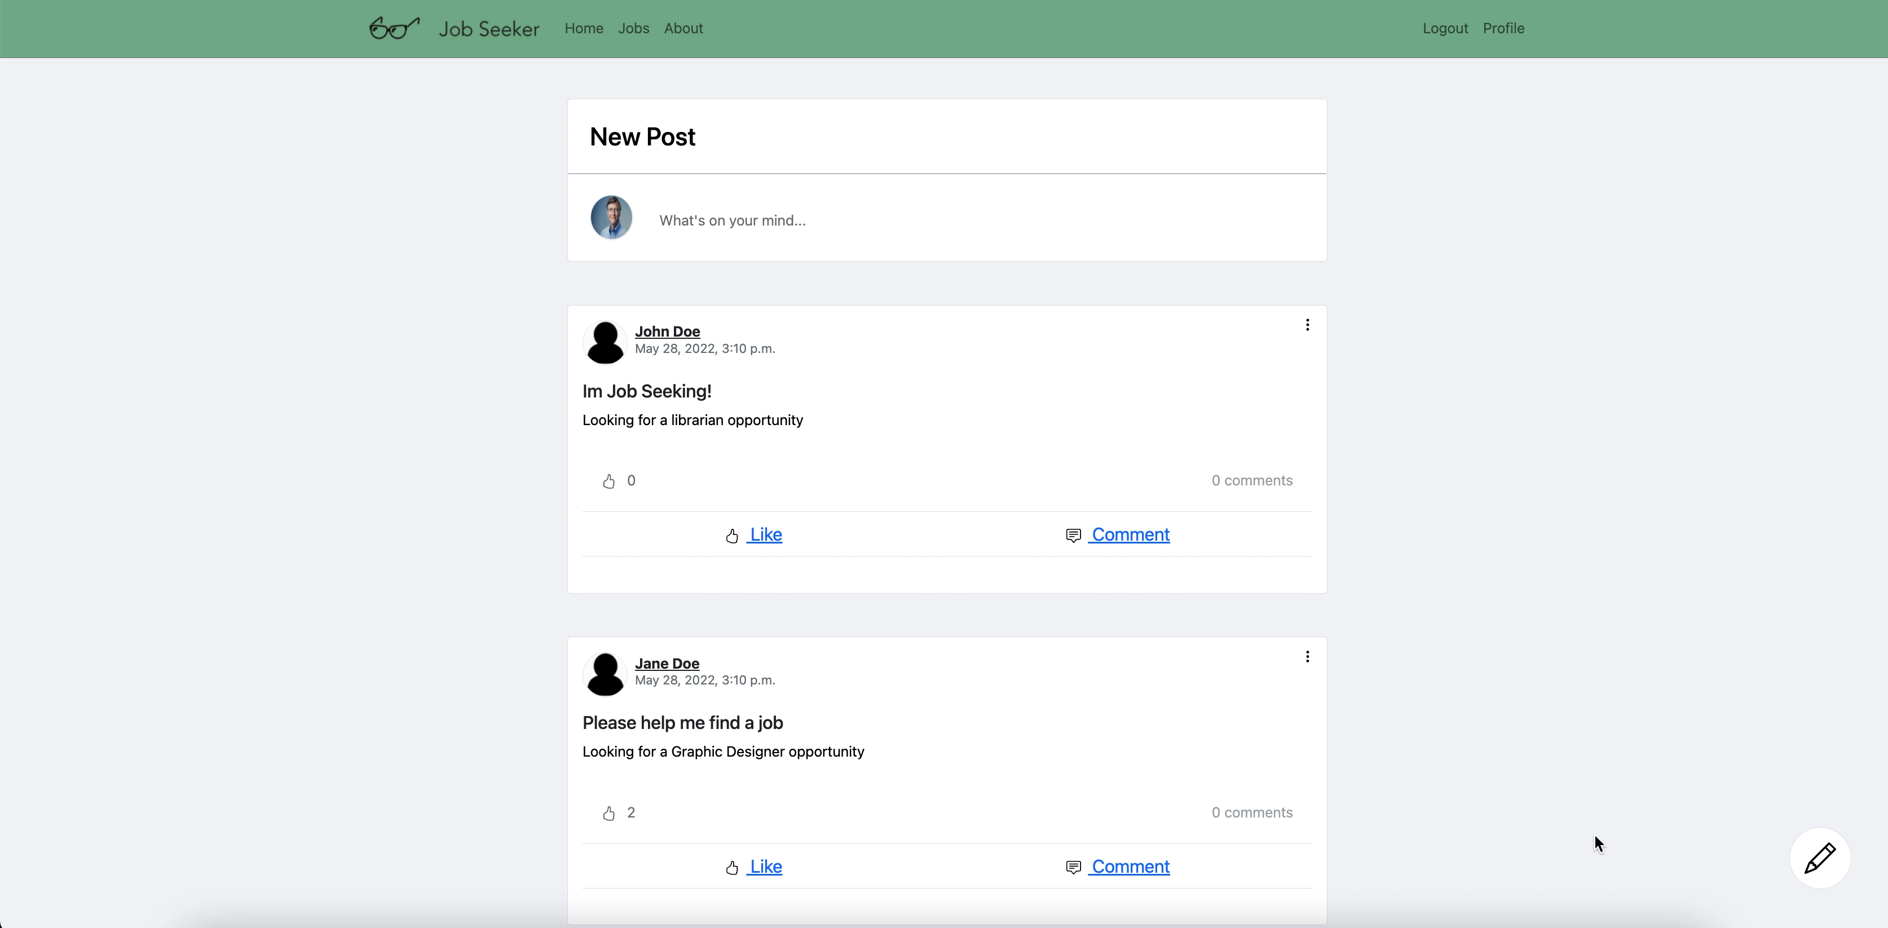

Slide 9
